Slide 1
Virtual Key for Your Repositories
Phase End Project

Slide 2
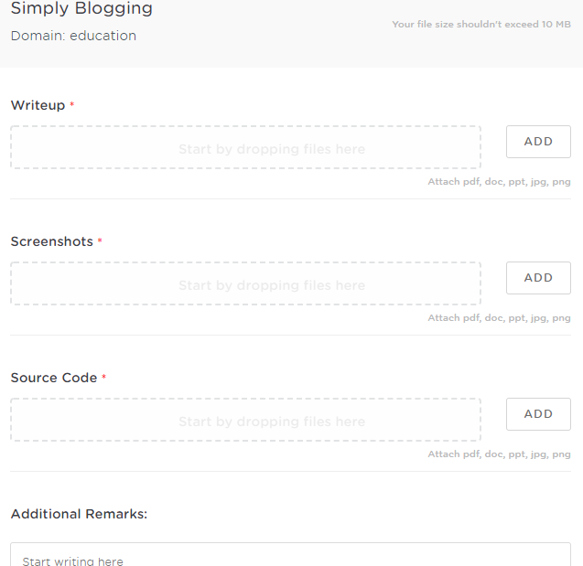
Project Submission Steps
After you click on submit you will get a window as below

Slide 3
Important things to consider
Write Up
Don’t push the document into the Git repository, use .gitignore file
Better create separate folder for the project inside the git repository
Mention the Git repo link in the document
Mention the folder name that has project in the document
Give brief information about the source code files to make us understand what is the file purpose in the document.
EX: App.java Main class details which contains all operations.
The operation class which help to do all operation depending upon the application requirements.

Slide 4
Important things to consider
Screenshot
Add the output screen shot of the project
You are allowed to add multiple screen shots in case required
Source Code
Wrap all the source codes like .java and .class in a zip
Upload the zip
If in case zip is not supported you can attach all source codes one by one
Note:
While pushing the project in Git repository you can have all your assignments and projects in a single repository
Create separate folders for each project in the Git repository, however you can mention these folder names in the document

